Slide 1




ECE477 Midterm Design Review: Team #16
Abby Haluska
Team Lead
Cameron McCutcheon
Hardware Engineer
Joey Collins
Software Engineer
John Morton
Systems Engineer
Notes:
- abby
-

Slide 2
Outline
Project Overview
Major Components
Block Diagram
Packaging Design
Electrical Schematic
PCB Layout
Prototyping Progress
Software Development Status
Project Timeline
Questions
Notes:
- abby

Slide 3
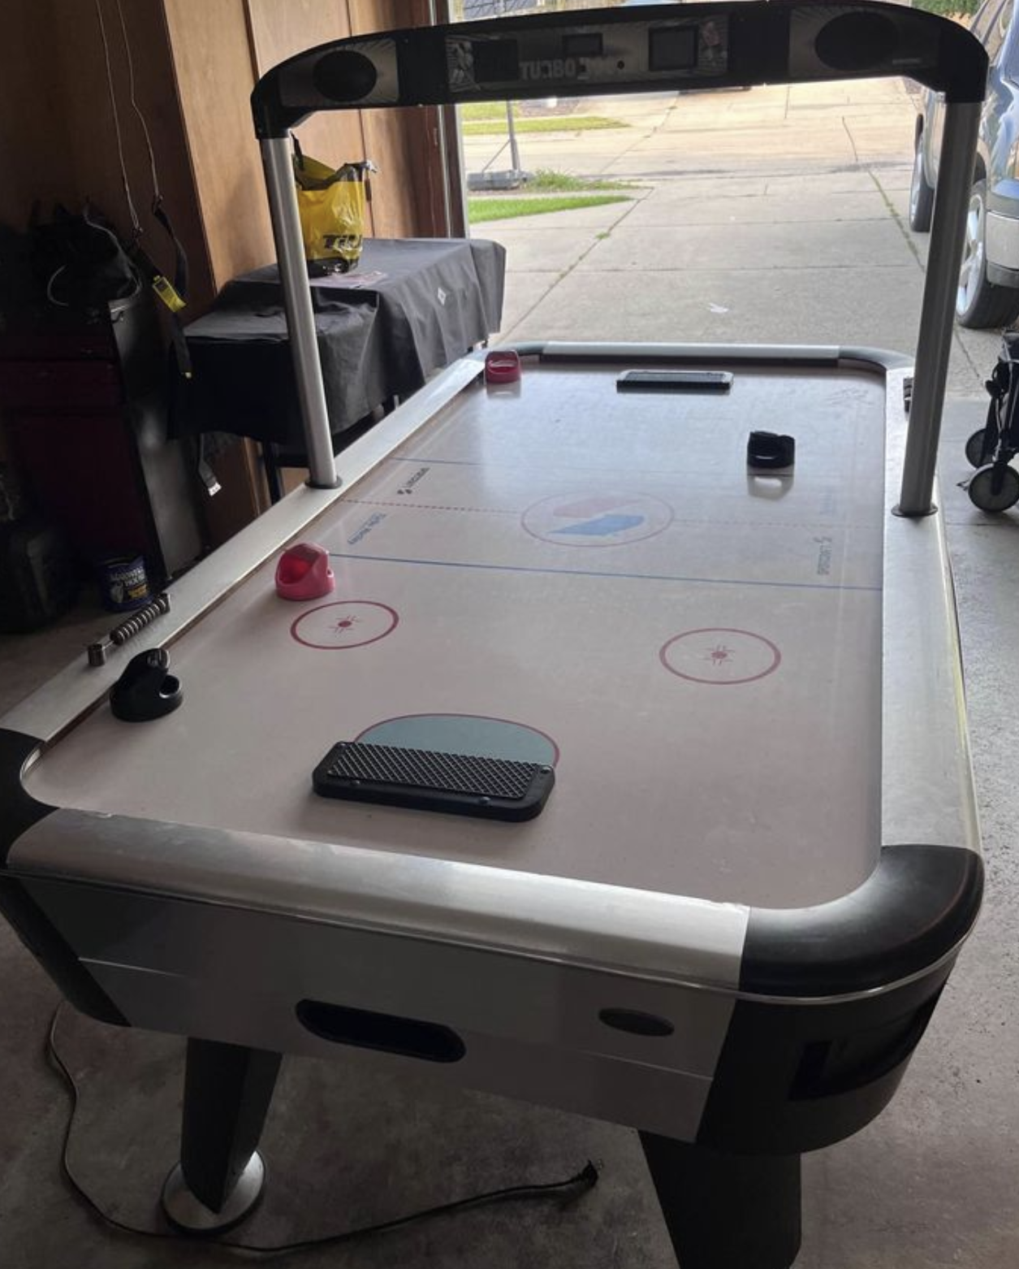
Project Overview
Autonomous Air Hockey Robot
A robot designed to oppose a human player in a game of air hockey
For hobbyists & enthusiasts
Uses computer vision to determine a puck’s trajectory
The microcontroller then adjusts the position of the paddle via motor control to defend and attack
Notes:
Abby
-
In this section provide a concise description of your project (you should start with your Project Description from your team website and then elaborate). What is it? What will it do? What differentiates it from similar projects and prior art? Include a relevant picture of your project or “artist rendering” of the completed project.

Slide 4
PSDRs
Project Specific Design Requirements + Stretch Goals
PSDR #1 (Hardware): An ability to use a microcontroller to control the XY directions of a gantry system using PWM and 2 motors.
PSDR #2 (Hardware): An ability to interface with an IC to establish communication and send data between a microcontroller and a PC via UART.
PSDR #3 (Hardware): An ability to interface a seven-segment display scoreboard with shift registers.
PSDR #4 (Hardware): An ability to keep score with a microcontroller by counting the number of times an interrupt is triggered by a puck passing through an infrared laser beam.
PSDR #5 (Software): An ability to estimate the position and trajectory of a puck in motion using computer vision.
SPSDR #1 (Hardware): An ability to amplify a PWM signal using an amplifying circuit to produce sound using speakers in the scoreboard system.
SPSDR #2 (Hardware): An ability to use button input to determine robot reaction speed by adjusting motor speed in software.
Notes:
Abby
- summarize PSDRs

Slide 5
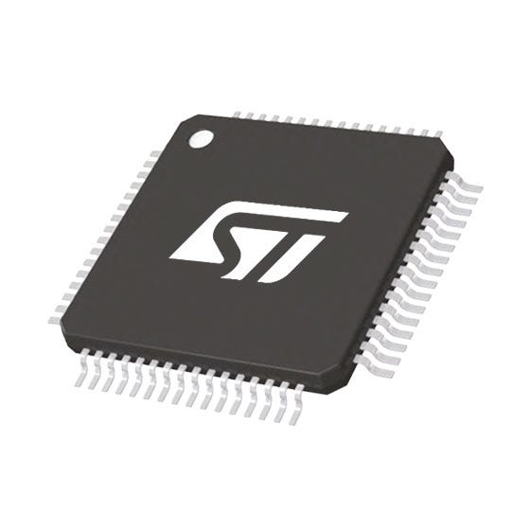
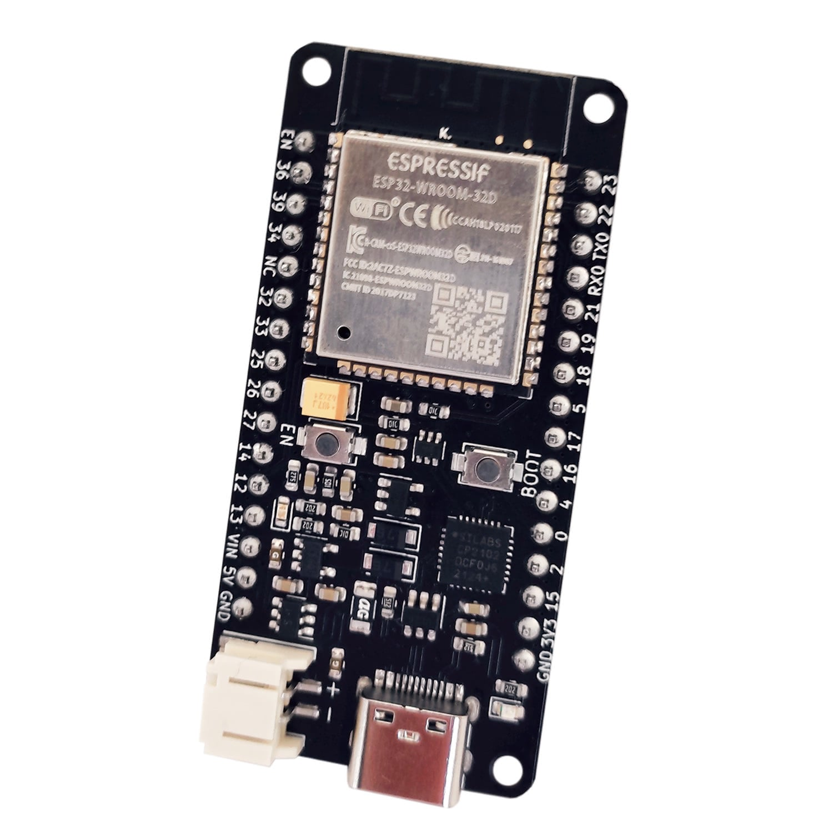
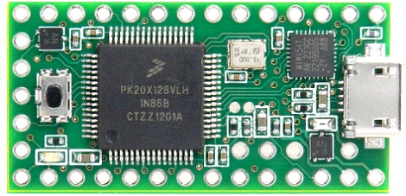
Major Components – micro
stm32f091rct6
Specifications:
# of I/O Pins
Clock speed
Independent communication channels
3.3V Operating Voltage
Options:
STM32F091RCT6
Teensy 3.0
ESP32 Wroom
Final Choice: STM32F091RCT6
ARM Cortex - familiar environment and community support
48 MHz max clock speed
Plenty of timers
Sufficient SPI + UART channels
Low cost
Notes:
Abby
- esp32 was considered for wifi, ruled out once we decided uart
- teensy is costly, stm is $5
- stm has more uart and spi channels than teensy

Slide 6
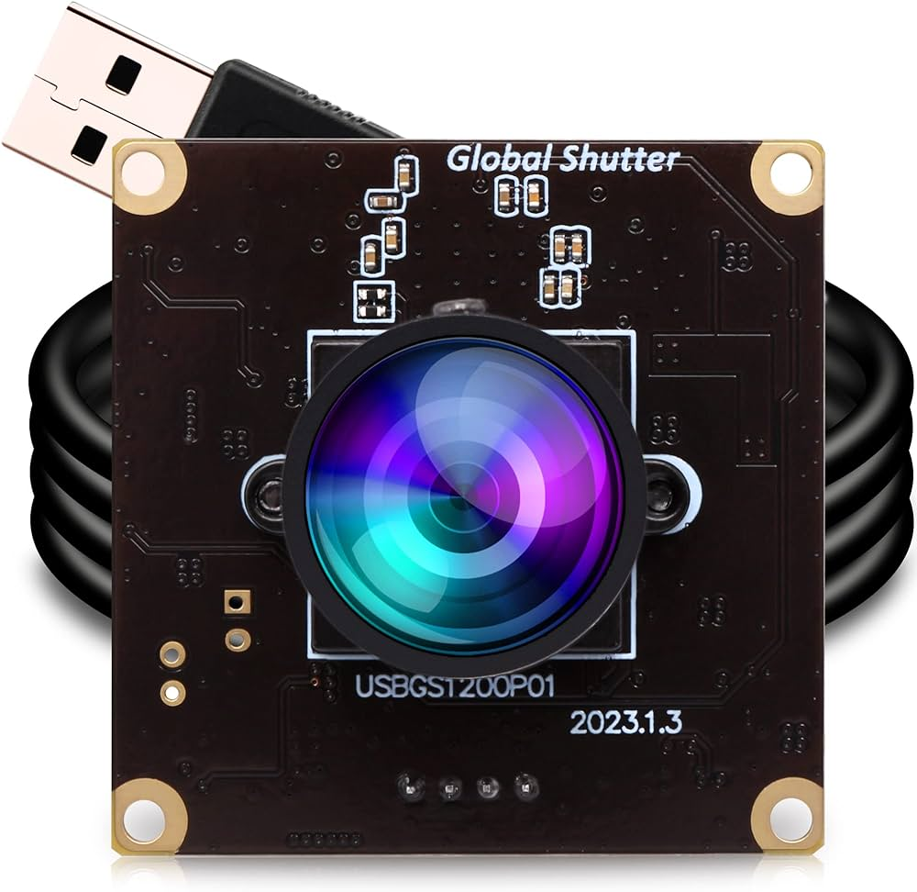
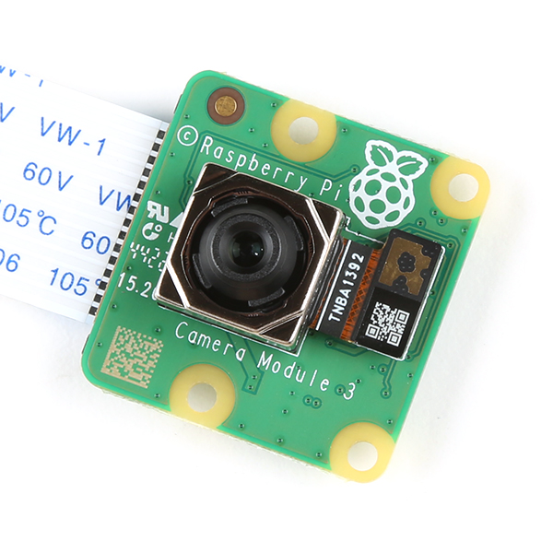
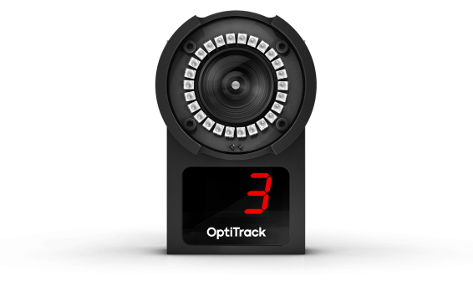
Major Components – Camera
ELP high speed Global Shutter camera
Specifications:
Framerate
Latency
Cost
Options:
ELP Camera
OptiTrack Flex 3
Raspberry Pi Camera Module
Final Choice: ELP Camera
Framerate: 120 fps
Latency: 60 ms
Price: $80
Connection: USB 2.0
Global Shutter
Notes:
Abby
- OptiTrack was too expensive
- Pi had too high of a latency
- ELP was good middle ground
- global shutter good for capturing moving objects
- freeze frame pics w lil / no blur

Slide 7
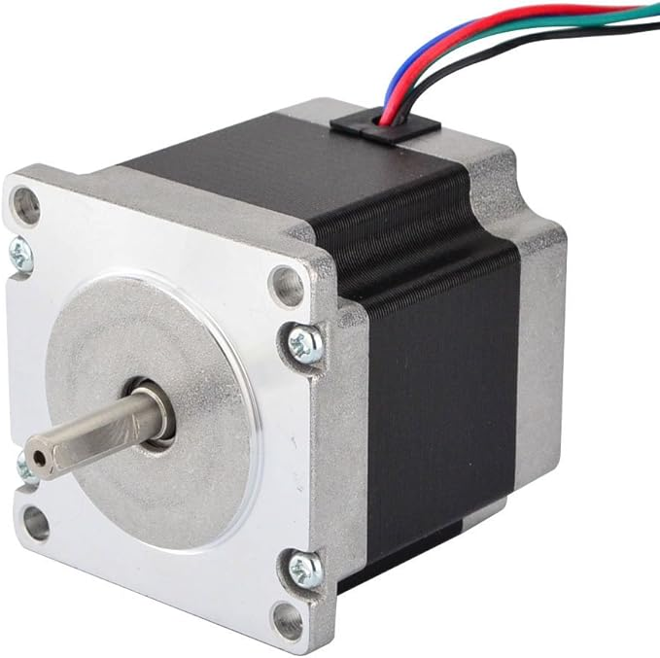
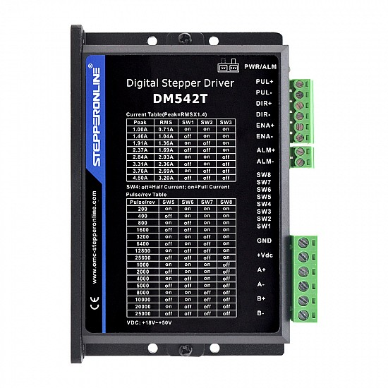
Major Components - Motors
NEMA 23 Stepper Motors | DM542T Stepper Drive
Specifications:
Steps / revolution
Current draw
Torque
Max voltage
Options:
NEMA 23 Stepper Motor
Brushless 3 Phase DC Motor
Synchronous Gear AC
Final Motor Choice: NEMA 23 Stepper Motor
1.8 steps/revolution
2.8A drawn per phase
1.9 Nm holding torque
48V max voltage
Final Motor Driver Choice: DM542T Stepper Driver
18 – 50 V DC Input voltage
1 – 4.5 A Output peak current
Multi-stepping for smooth motor movement
Notes:
Abby
- stepper motor allows high accuracy, little speed/power sacrificed
- NEMA provides ample torque at good price
- DC would have provided high speed, but not enough accuracy
- AC motor are slower and lower torque

Slide 8
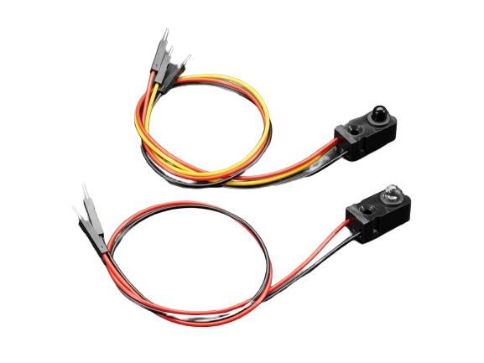
Major Components – IR Sensors
Adafruit IR break beam sensors
Specifications:
Sensing distance
3.3V power voltage
Response time
Options:
Adafruit IR Break Beam Sensor
DFRobot IR Break Beam Sensor
Final Choice: Adafruit IR Break Beam Sensor
50 cm sensing distance
3.3V power voltage
10 mA current draw
< 2 ms response time
Notes:
Abby
Choose the major (electrical) components being utilized by your design. For each component, provide a brief description of what it is, relevant specifications, and what it will do. Examples of major components include the microcontroller, motors, wireless interfaces, power converters and regulators. Examples of relevant specifications include operating speed (uC), number of I/O (uC), stall current (motors), operating voltage, and expected current consumption

Slide 9
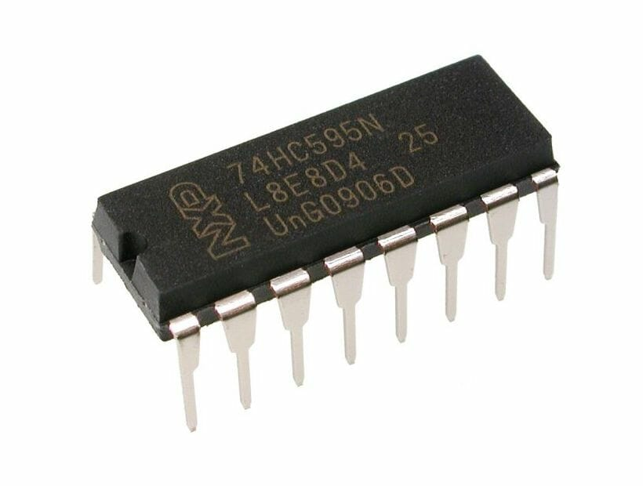
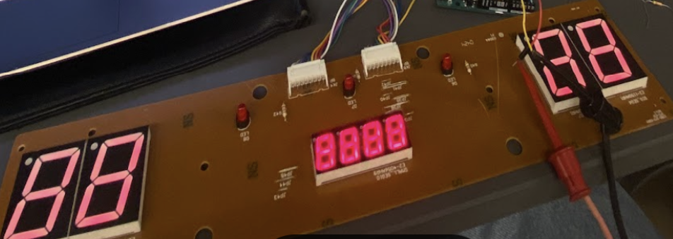
Major Components – Scoreboard
74HC595 Shift Registers | 7-segment displays
Specifications:
Operating voltage
Low power consumption
Final Shift Register Choice: 74HC595
Availability
3.3V operating voltage
Low power consumption
Final Shift Register Choice: Common Cathode 7-Segments
Availability
Compatibility with Air Hockey Table
Notes:
Abby
Choose the major (electrical) components being utilized by your design. For each component, provide a brief description of what it is, relevant specifications, and what it will do. Examples of major components include the microcontroller, motors, wireless interfaces, power converters and regulators. Examples of relevant specifications include operating speed (uC), number of I/O (uC), stall current (motors), operating voltage, and expected current consumption

Slide 10
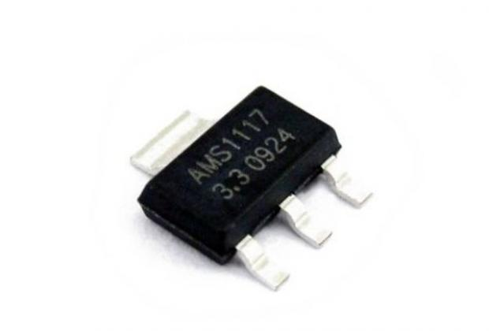
Major Components – other
AMS1117 LDO
Specifications:
Output voltage
Output current
Options:
LMS1585ACS
Final Choice: AMS1117 Voltage Regulator
5V to 3.3V application
1A output current
Packaging
Industry standard
Notes:
Abby
- does the right application, availability, convenience
Choose the major (electrical) components being utilized by your design. For each component, provide a brief description of what it is, relevant specifications, and what it will do. Examples of major components include the microcontroller, motors, wireless interfaces, power converters and regulators. Examples of relevant specifications include operating speed (uC), number of I/O (uC), stall current (motors), operating voltage, and expected current consumption

Slide 11
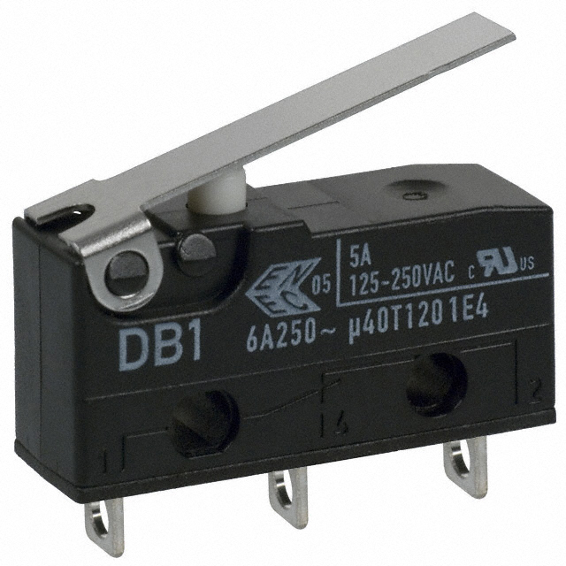

Major Components – other
Other major components
Limit switches for a secure gantry system
PC for handling all data received from the camera
Notes:
Abby
- does the right application, availability, convenience
Choose the major (electrical) components being utilized by your design. For each component, provide a brief description of what it is, relevant specifications, and what it will do. Examples of major components include the microcontroller, motors, wireless interfaces, power converters and regulators. Examples of relevant specifications include operating speed (uC), number of I/O (uC), stall current (motors), operating voltage, and expected current consumption

Slide 12
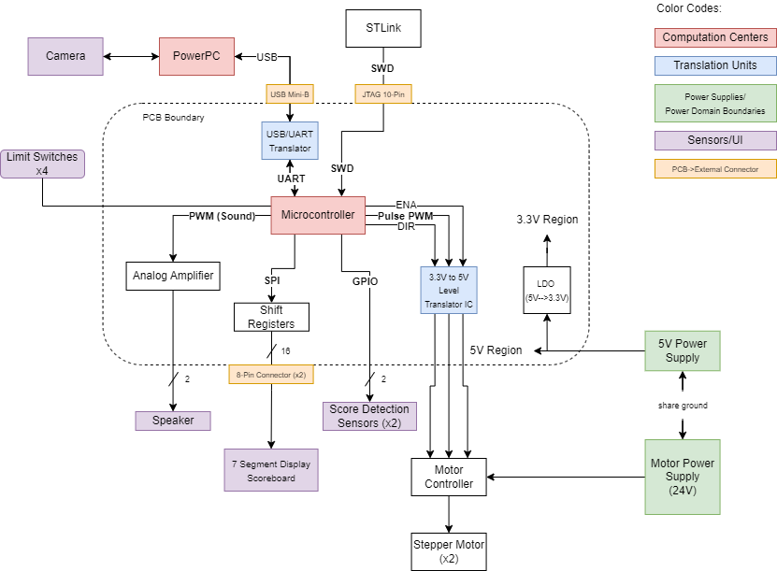
Block Diagram
Block Diagram
Notes:
john

Slide 13
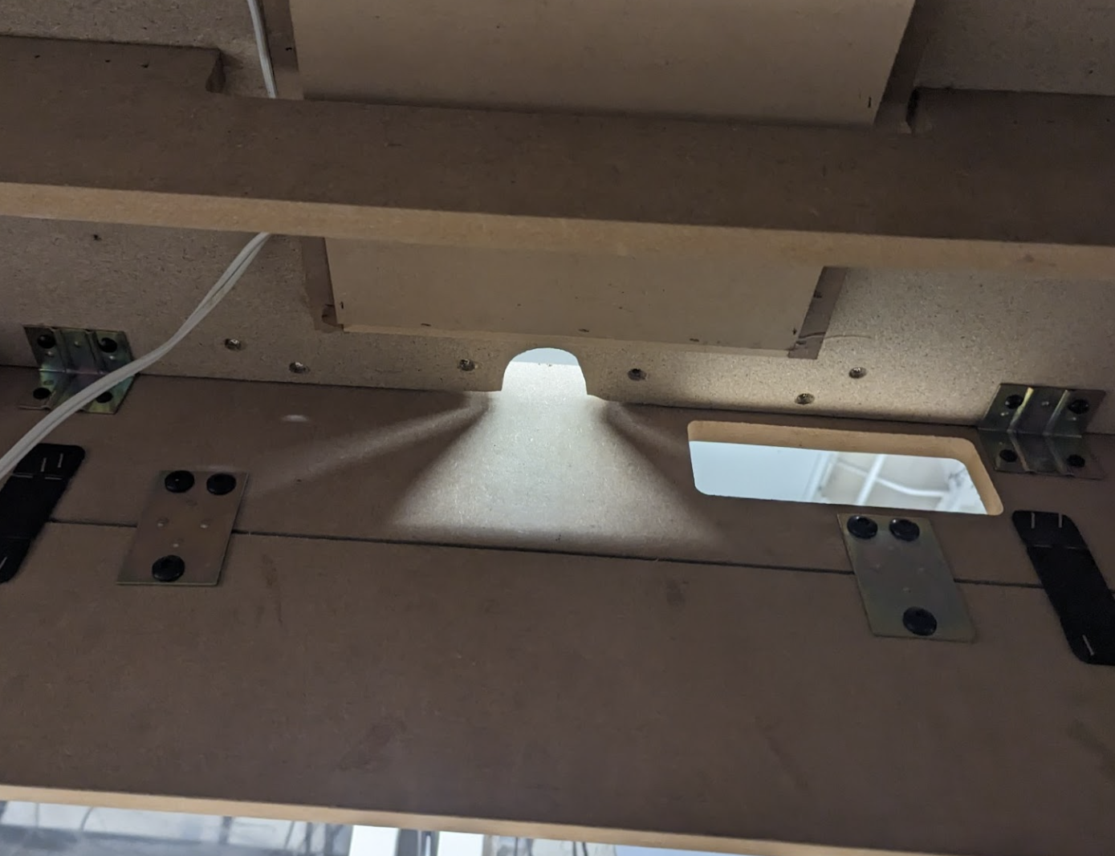
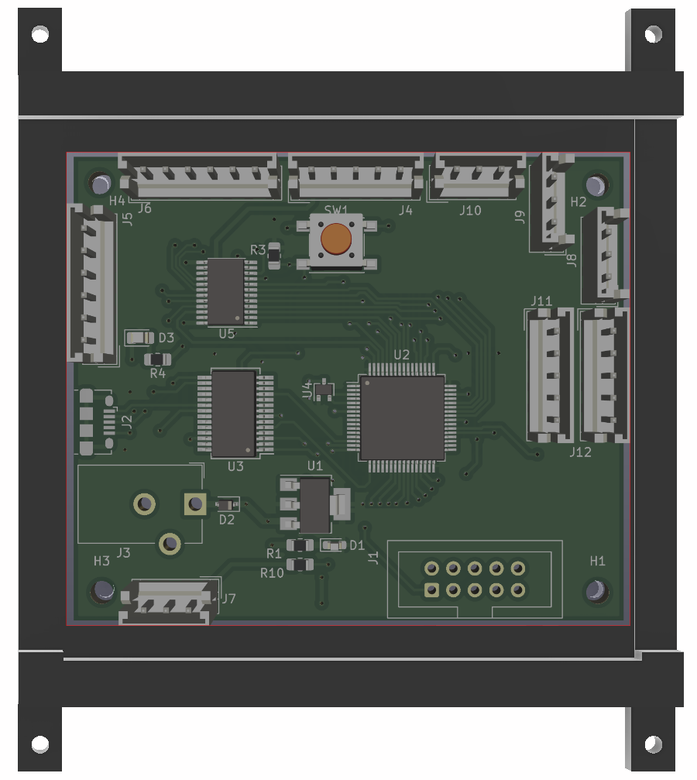
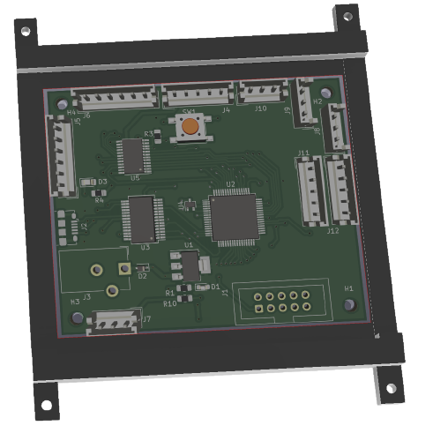
Packaging Design
PCB housing
3D printed mount + lid
Notes:
Pcb is 2.5 in x 2.35 in
Mounting holes r .116 in from each corner

Slide 14
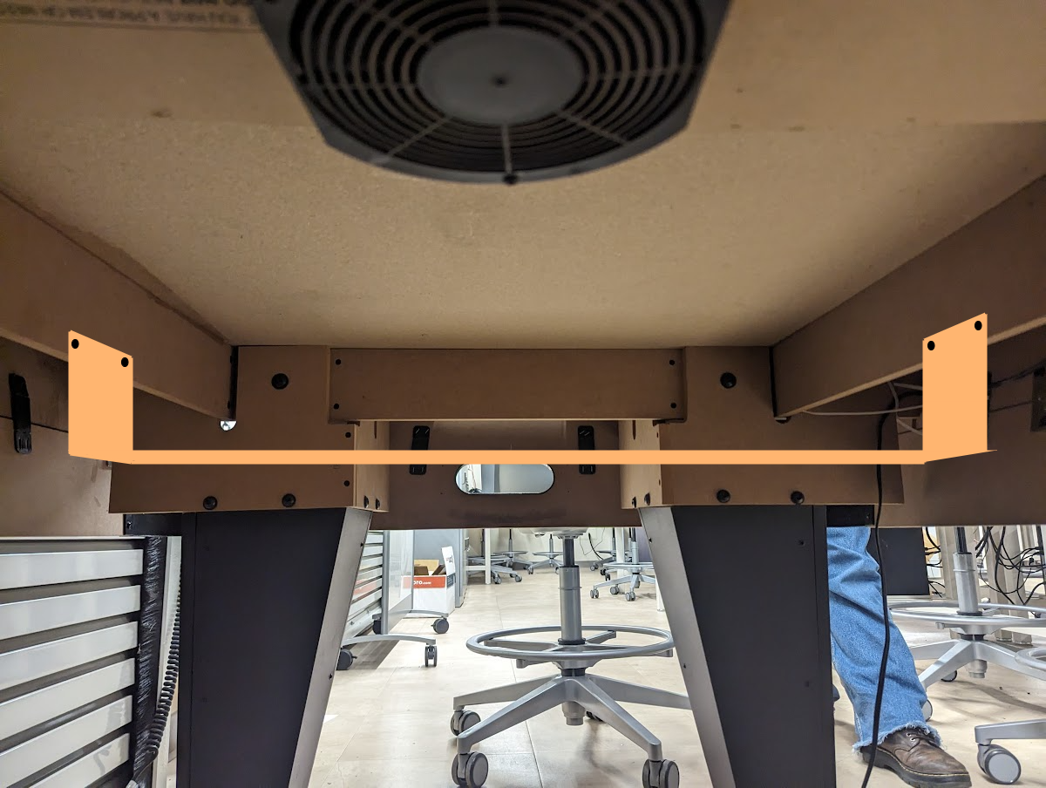
Packaging Design
PC housing
Wood Support for PC. Any laptop will fit on here.
Where is the pc going
Notes:
Pcb is 2.5 in x 2.35 in
Mounting holes r .116 in from each corner

Slide 15
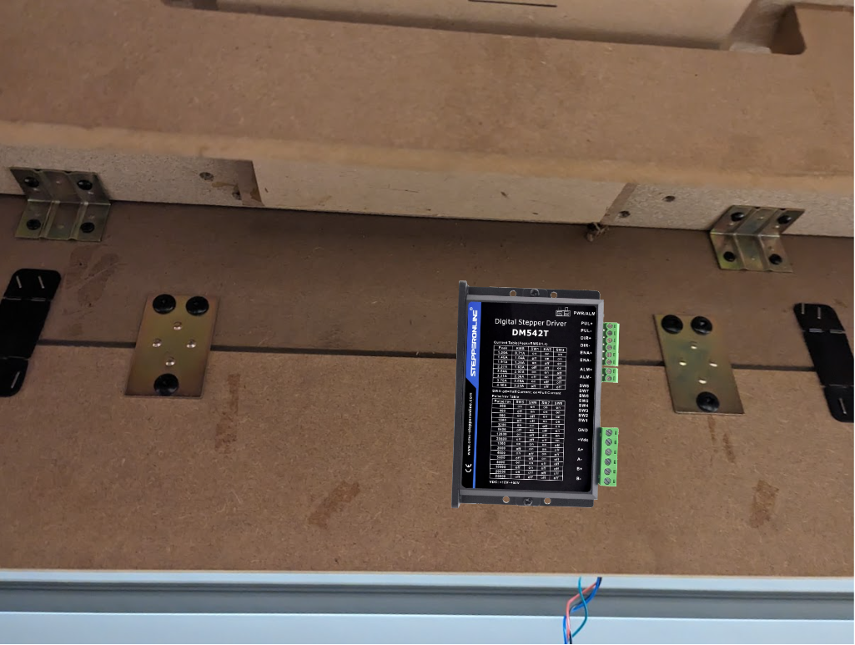
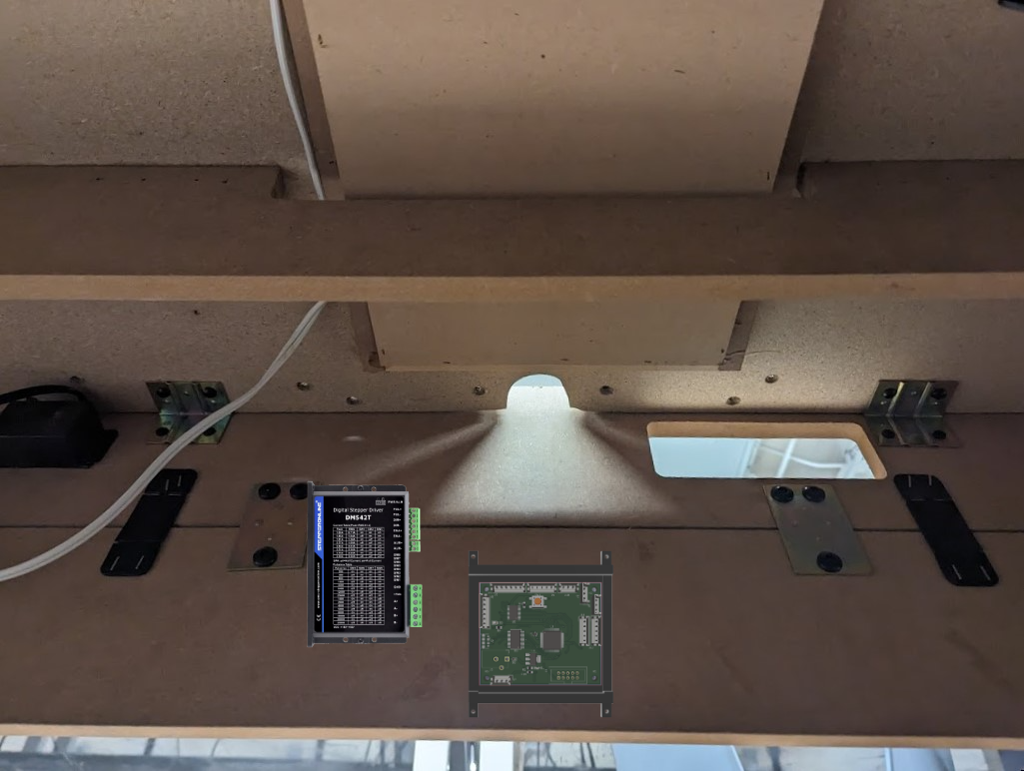
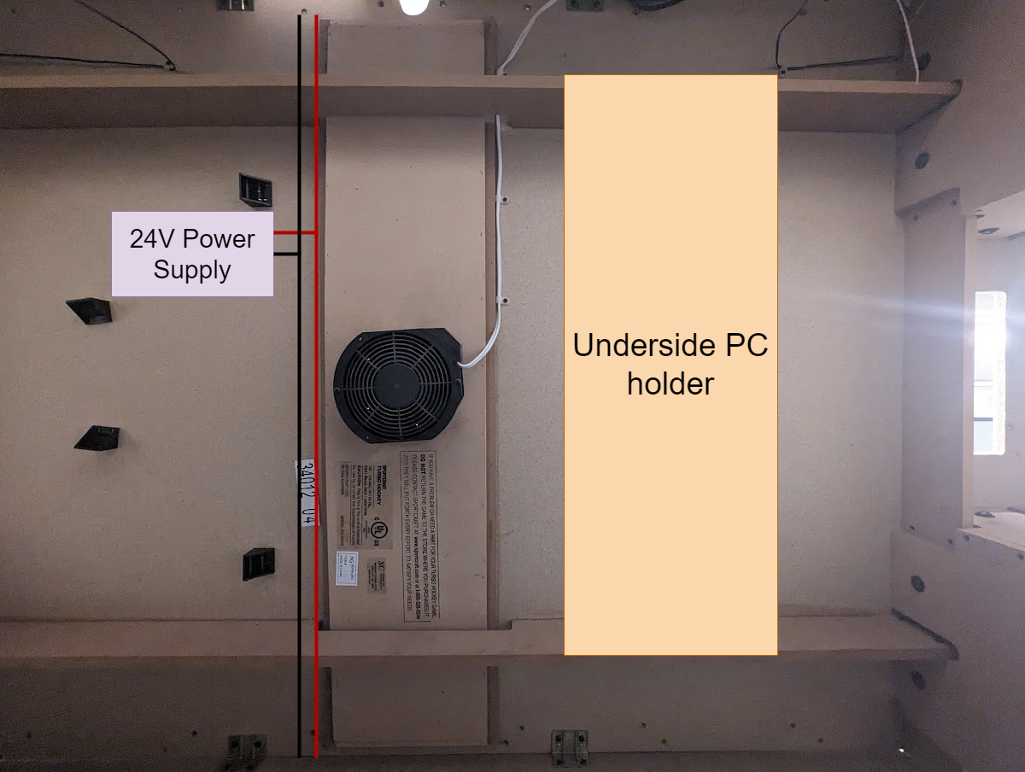
Packaging Design
Power Supply Housing
Notes:
Pcb is 2.5 in x 2.35 in
Mounting holes r .116 in from each corner

Slide 16
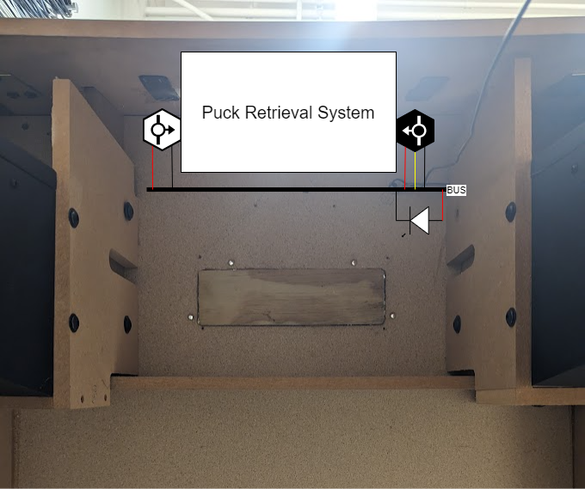
Packaging Design
Power Supply Housing
Sensor Layout on underside
Notes:
Pcb is 2.5 in x 2.35 in
Mounting holes r .116 in from each corner

Slide 17
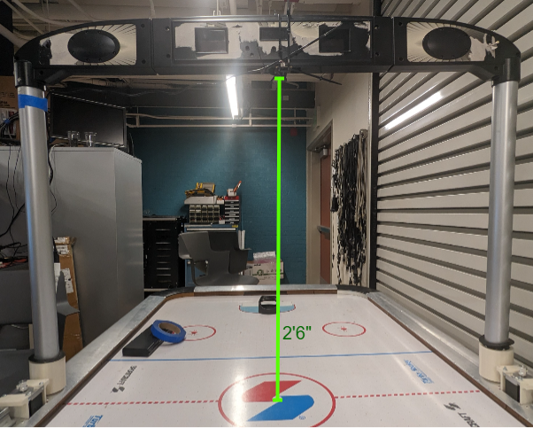
Packaging Design
Power Supply Housing
Notes:
Pcb is 2.5 in x 2.35 in
Mounting holes r .116 in from each corner

Slide 18
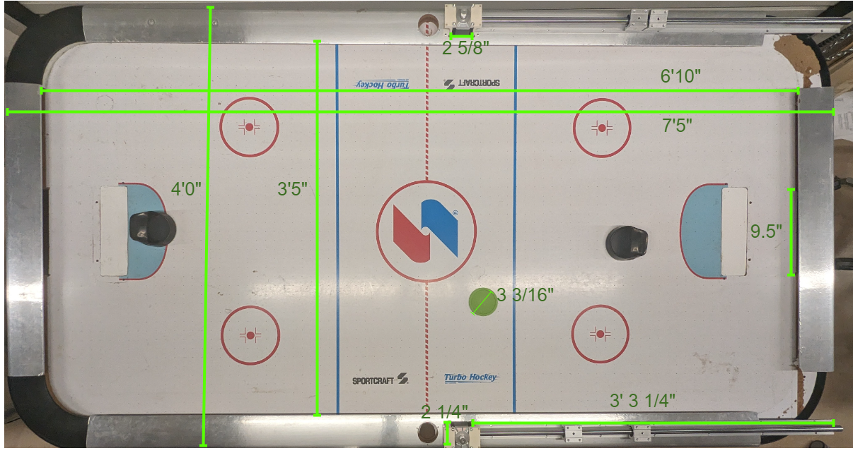
Packaging Design
Table Layout
Notes:
John Include one or more images of your packaging design here. Include relevant dimensions and how you are planning to manufacture your product packaging.

Slide 19
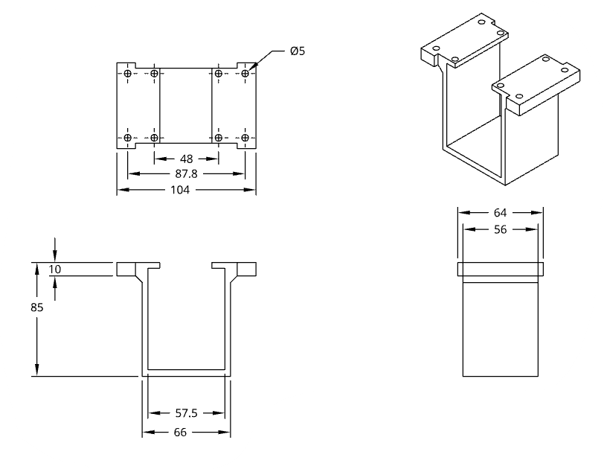
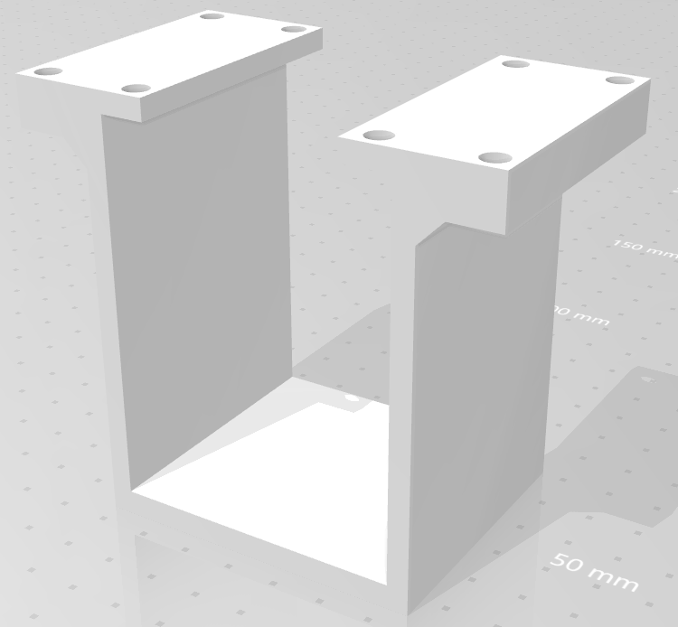
Packaging Design
Motor Bracket Housing
This is the housing bracket for the motors. They will be manufactured using resin from a 3d printer.
Notes:
john

Slide 20
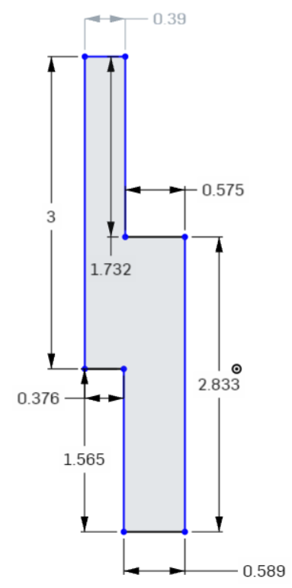
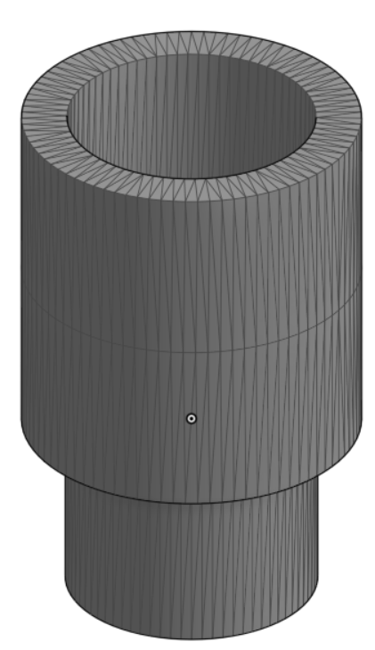
Packaging Design
HUD Extension
3D printed using PLA Filament
Notes:
john

Slide 21
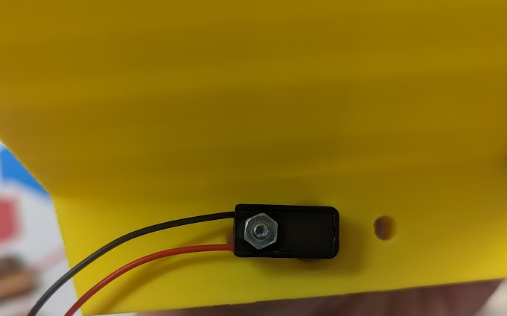
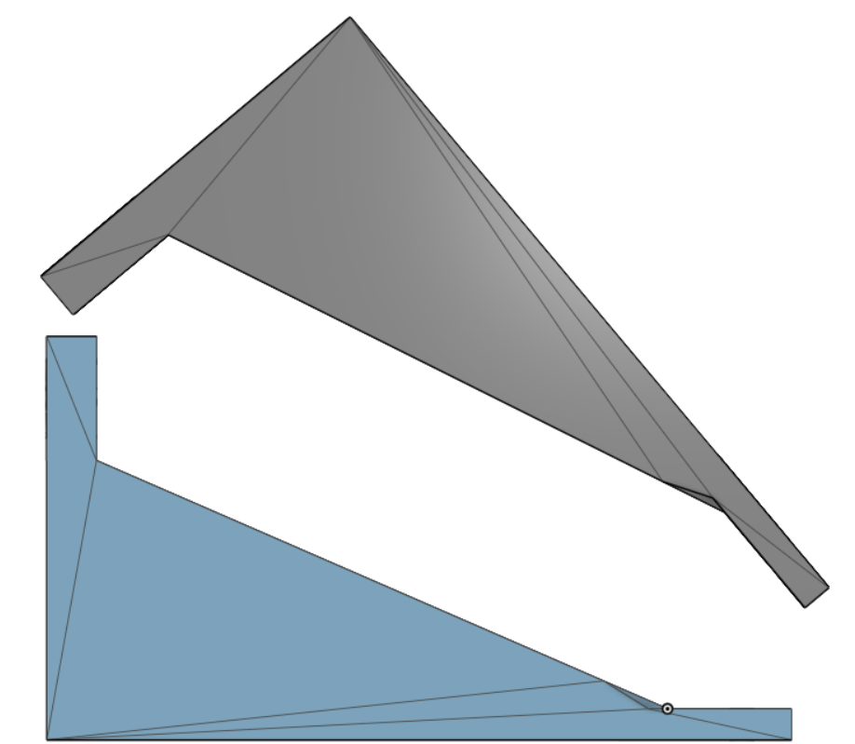
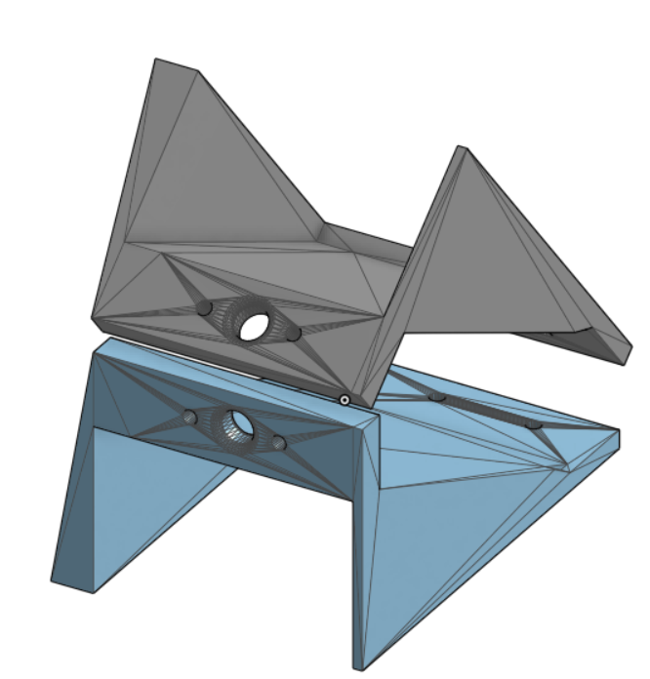
Packaging Design
Puck Retrieval System
Temporary design for Puck retrieval system.
Notes:
john

Slide 22
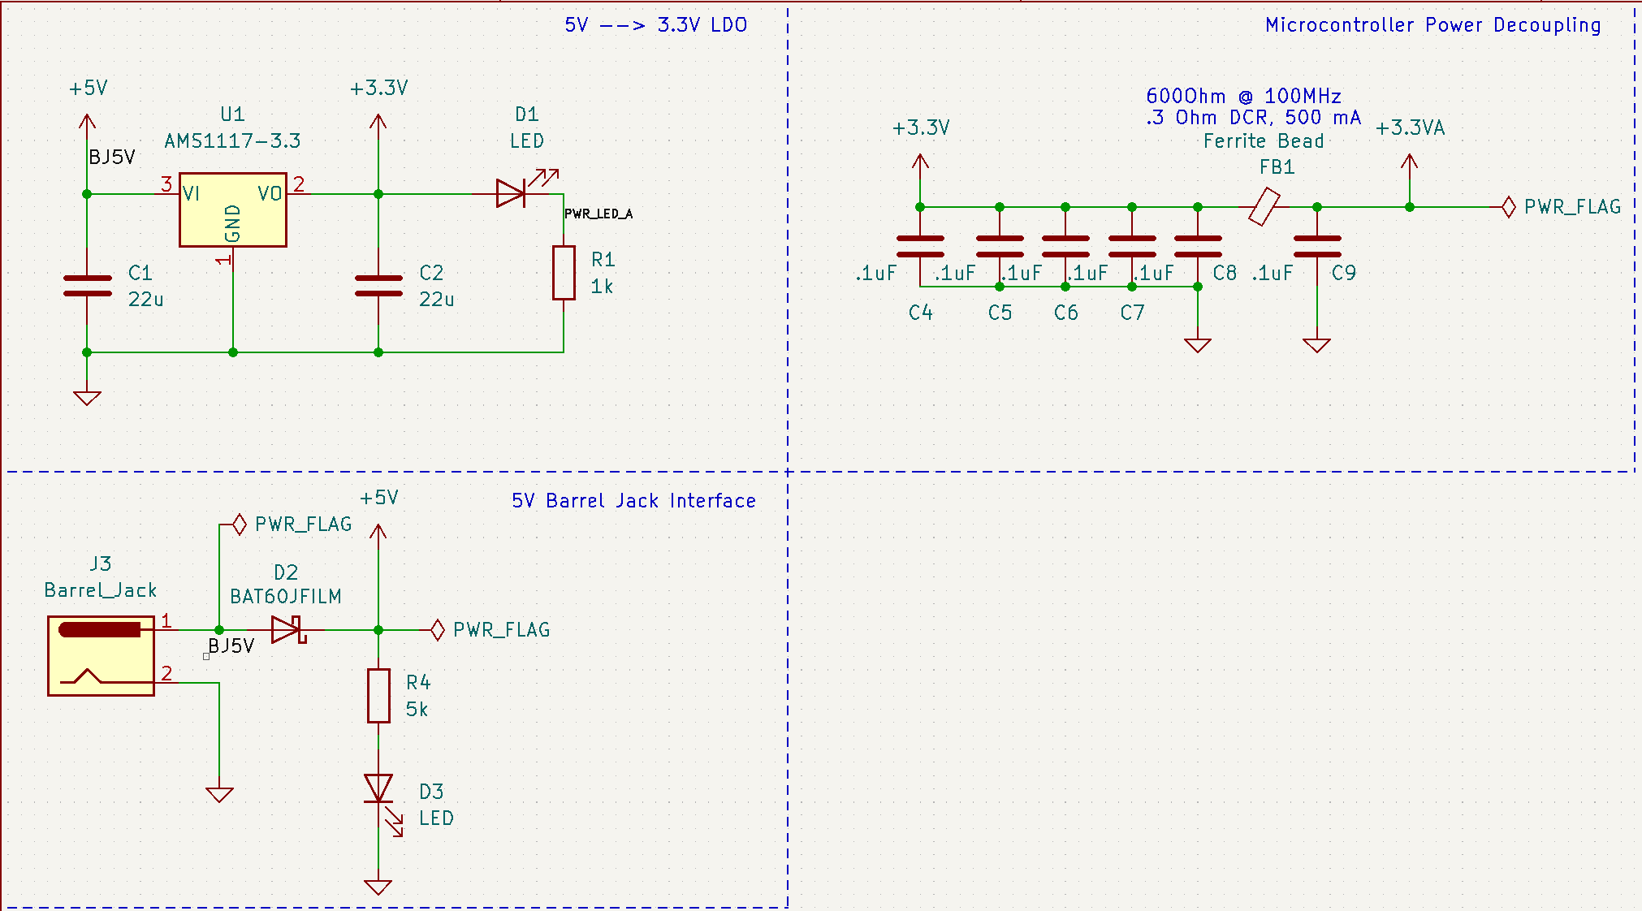
Electrical Schematic
Power
Notes:
cameron
Include one or more views of your electrical schematic here. If necessary, break up this section into multiple slides detailing various subsystems which are easily viewable (Hint: a zoomed out view of a large electrical schematic in which nothing can be read will not be helpful for the design review). Your schematics should be complete, organized, and readable.

Slide 23
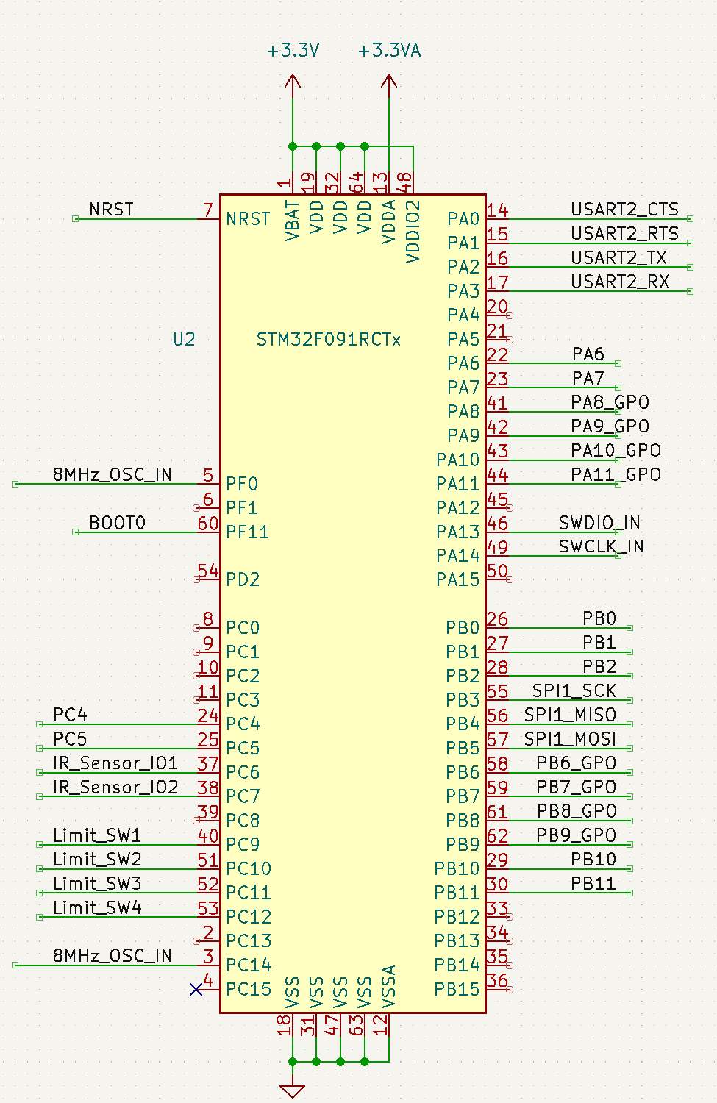
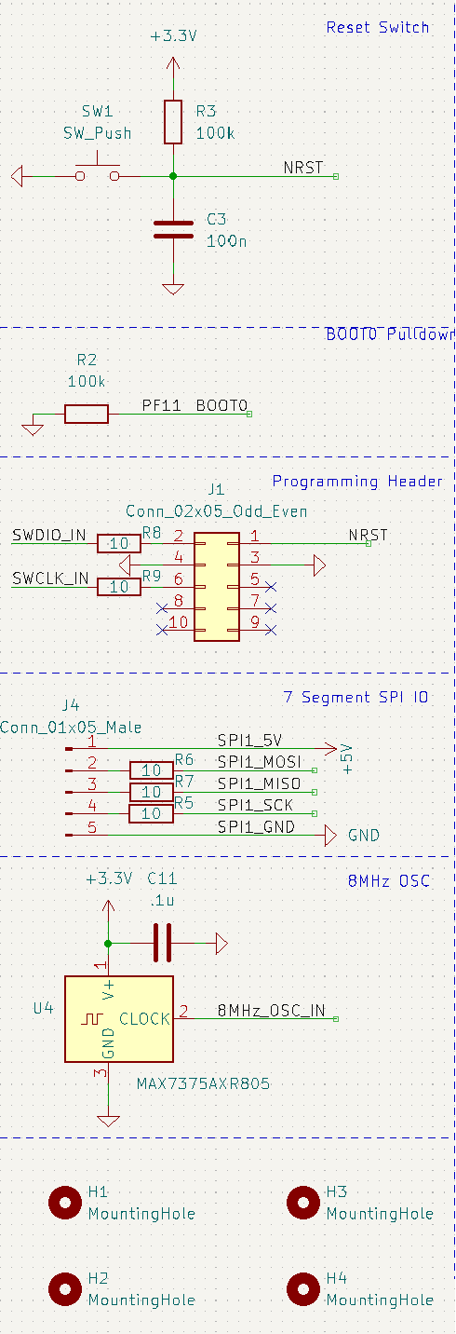
Electrical Schematic
Clock, micro, mounting holes
Notes:
cameron
Include one or more views of your electrical schematic here. If necessary, break up this section into multiple slides detailing various subsystems which are easily viewable (Hint: a zoomed out view of a large electrical schematic in which nothing can be read will not be helpful for the design review). Your schematics should be complete, organized, and readable.

Slide 24
Electrical Schematic
Reset switch, programming header,
Notes:
cameron
Include one or more views of your electrical schematic here. If necessary, break up this section into multiple slides detailing various subsystems which are easily viewable (Hint: a zoomed out view of a large electrical schematic in which nothing can be read will not be helpful for the design review). Your schematics should be complete, organized, and readable.

Slide 25
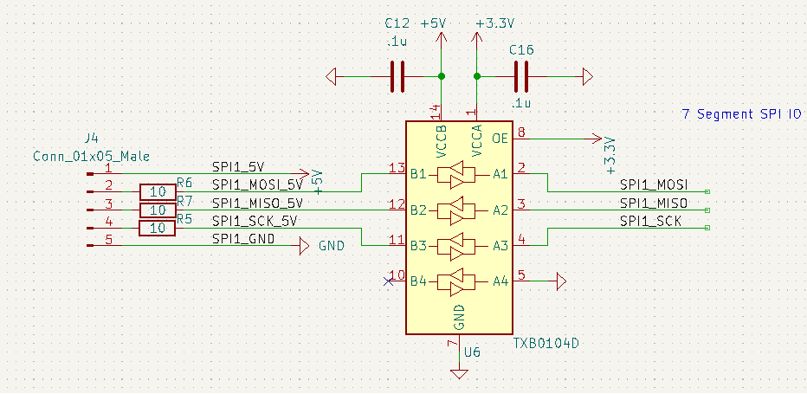
Electrical Schematic
spi
Notes:
cameron
Include one or more views of your electrical schematic here. If necessary, break up this section into multiple slides detailing various subsystems which are easily viewable (Hint: a zoomed out view of a large electrical schematic in which nothing can be read will not be helpful for the design review). Your schematics should be complete, organized, and readable.

Slide 26
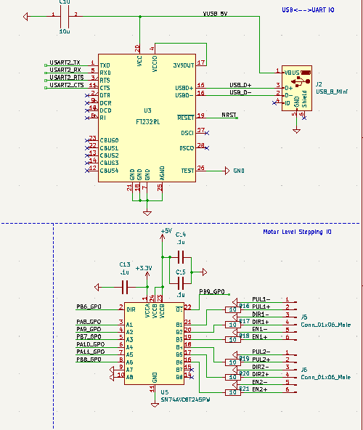
Electrical Schematic
Usb to uart ic
Notes:
cameron
Include one or more views of your electrical schematic here. If necessary, break up this section into multiple slides detailing various subsystems which are easily viewable (Hint: a zoomed out view of a large electrical schematic in which nothing can be read will not be helpful for the design review). Your schematics should be complete, organized, and readable.

Slide 27
Electrical Schematic
3.3 to 5V Level Translator
Notes:
cameron
Include one or more views of your electrical schematic here. If necessary, break up this section into multiple slides detailing various subsystems which are easily viewable (Hint: a zoomed out view of a large electrical schematic in which nothing can be read will not be helpful for the design review). Your schematics should be complete, organized, and readable.

Slide 28
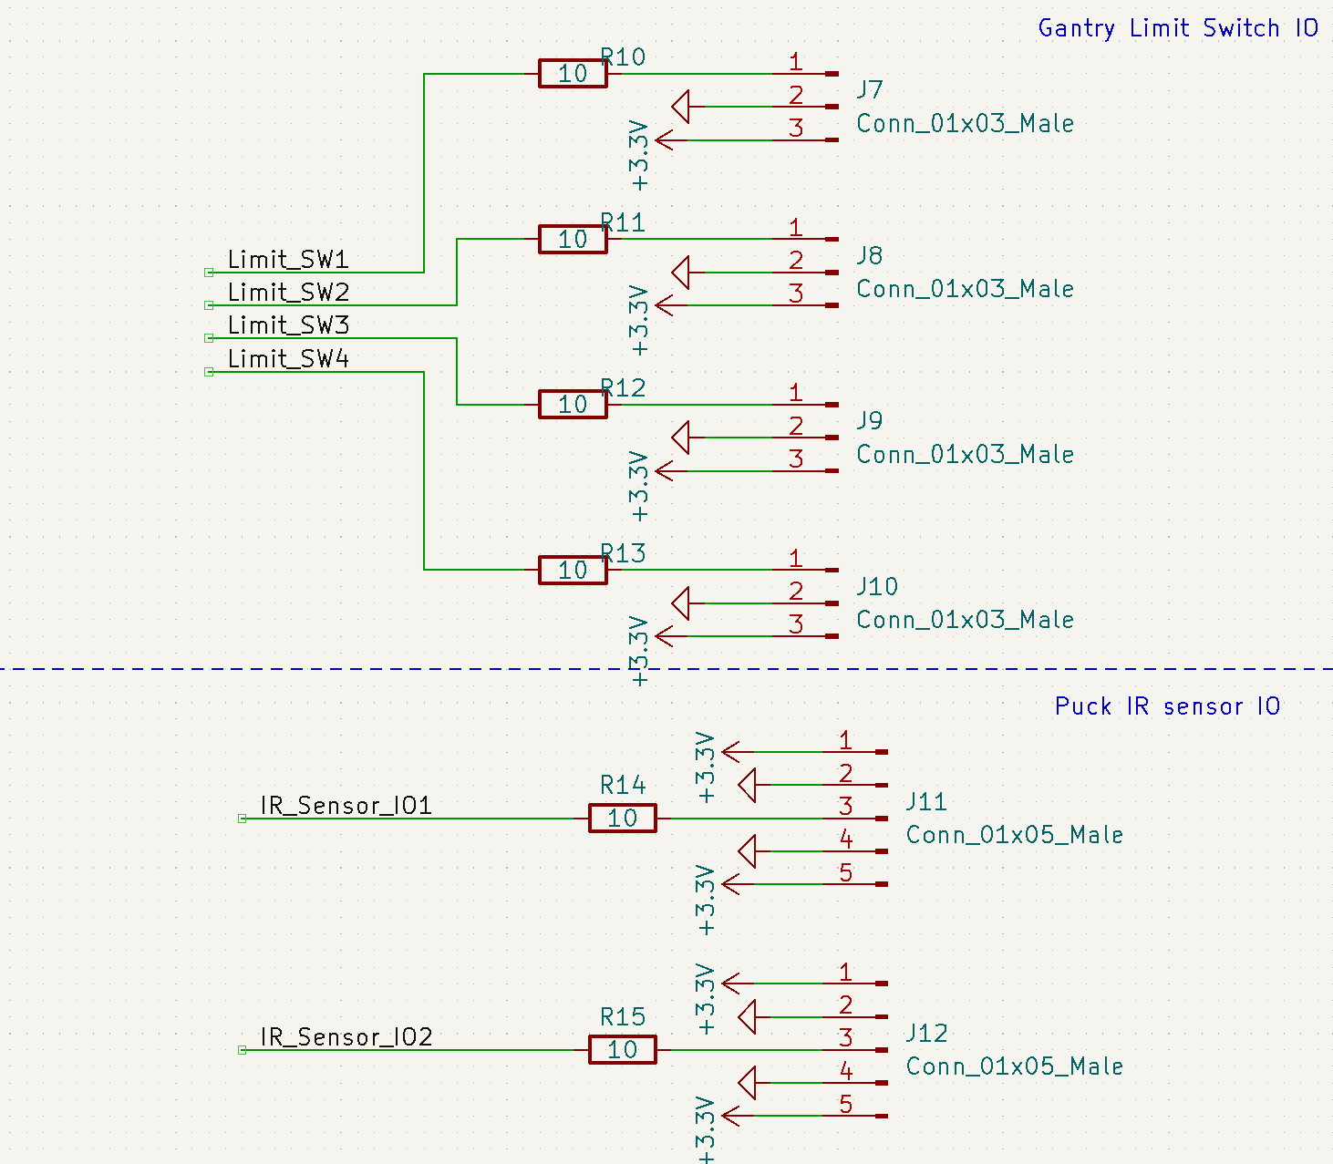
Electrical Schematic
Gantry limit switch gpio
Notes:
john
Include one or more views of your electrical schematic here. If necessary, break up this section into multiple slides detailing various subsystems which are easily viewable (Hint: a zoomed out view of a large electrical schematic in which nothing can be read will not be helpful for the design review). Your schematics should be complete, organized, and readable.

Slide 29
Electrical Schematic
Ir sensor gpio
Notes:
john
Include one or more views of your electrical schematic here. If necessary, break up this section into multiple slides detailing various subsystems which are easily viewable (Hint: a zoomed out view of a large electrical schematic in which nothing can be read will not be helpful for the design review). Your schematics should be complete, organized, and readable.

Slide 30
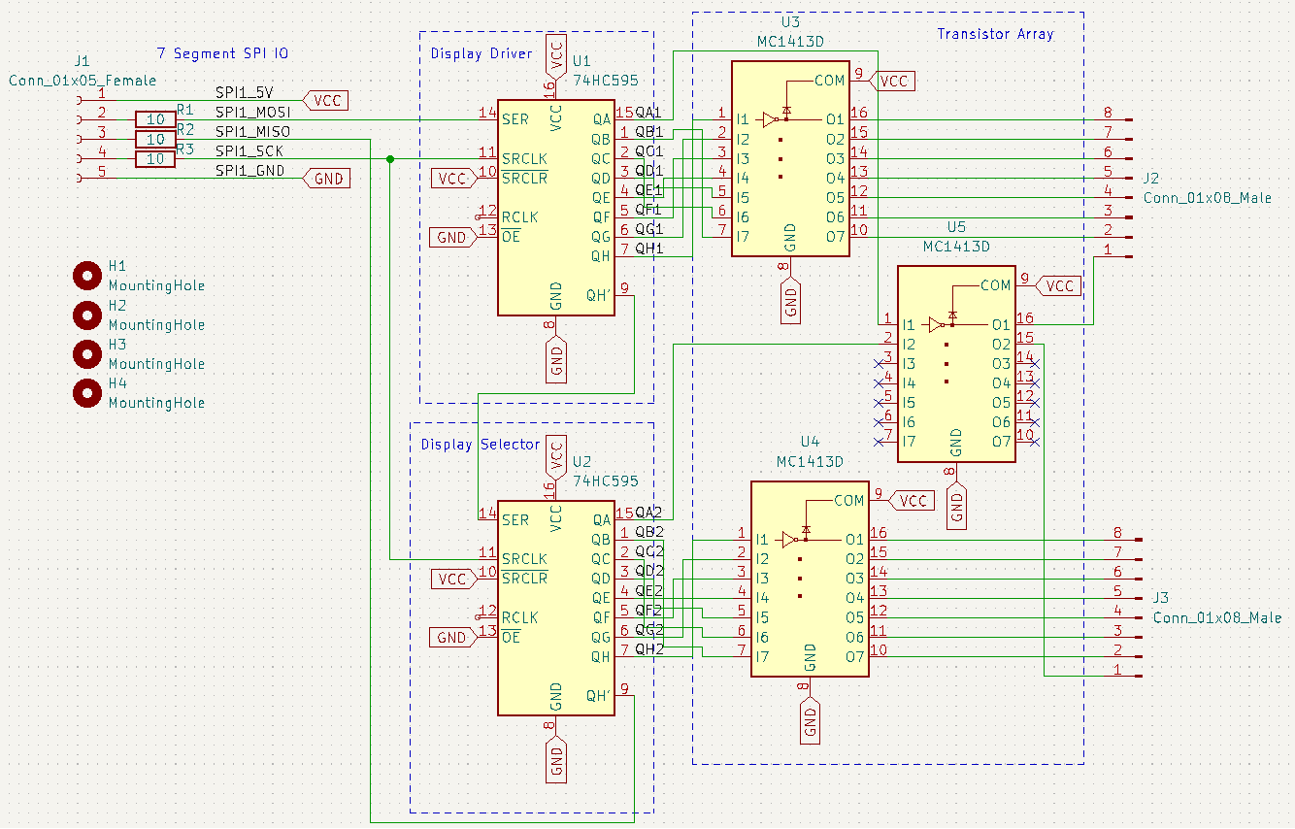
Electrical Schematic
SPI to 7-segment
Notes:
john
Include one or more views of your electrical schematic here. If necessary, break up this section into multiple slides detailing various subsystems which are easily viewable (Hint: a zoomed out view of a large electrical schematic in which nothing can be read will not be helpful for the design review). Your schematics should be complete, organized, and readable.

Slide 31
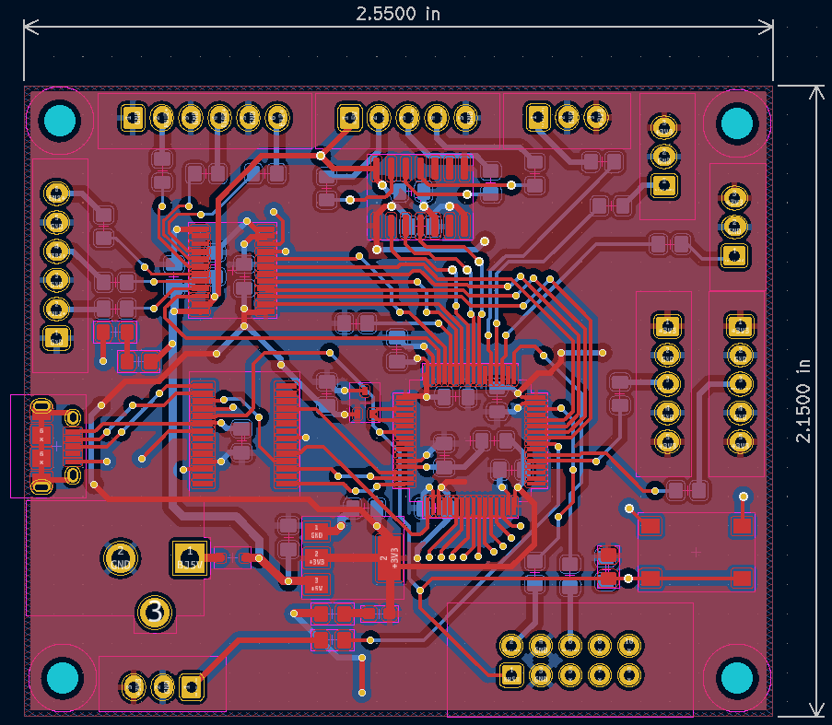
PCB Layout
Overview
Notes:
Include one or more views of your PCB Layout here. If necessary, break up this section into multiple slides detailing various subsystems which are easily viewable (Hint: a zoomed out view of a large electrical schematic in which nothing can be read will not be helpful for the design review). Your layout should be complete, organized, and readable.

Slide 32
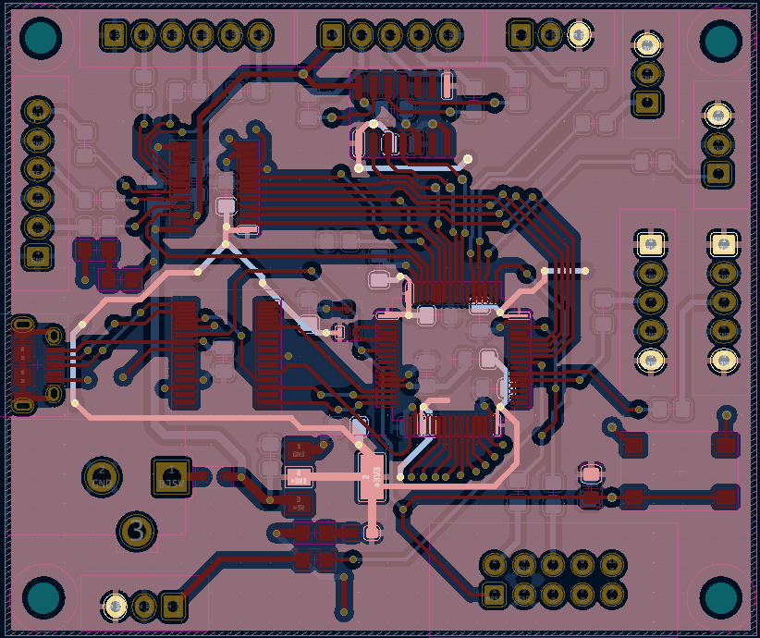
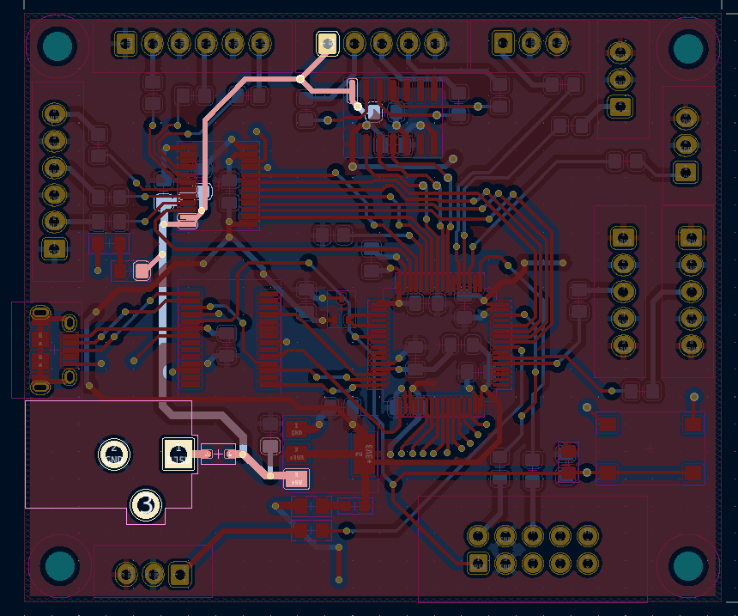
PCB Layout
Power
Power System with 5V Barrel Jack transformed to 3.3V for the rest of the board.
3.3V 5V
Notes:
cameron

Slide 33
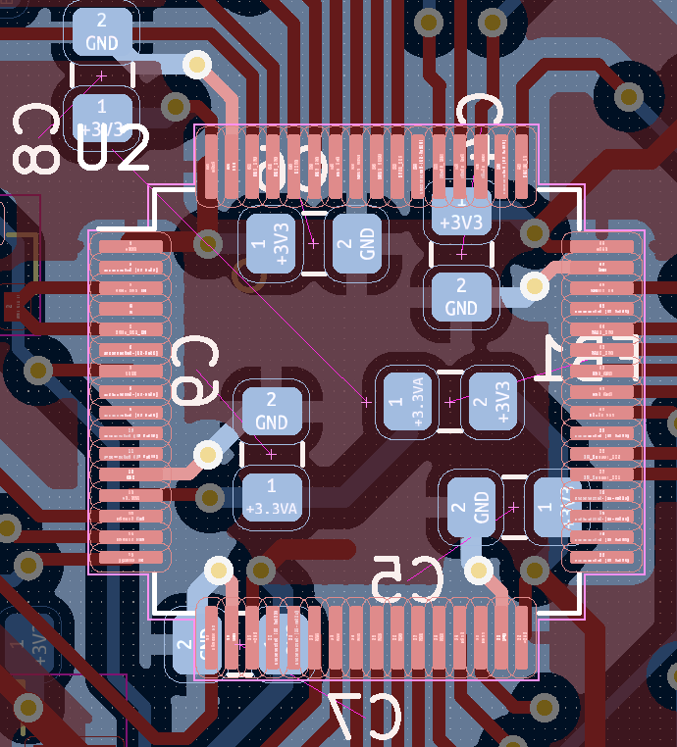
PCB Layout
MicroController and Decoupling Capacitors
Decoupling capacitors run on the underside of the board.
Notes:
cameron

Slide 34
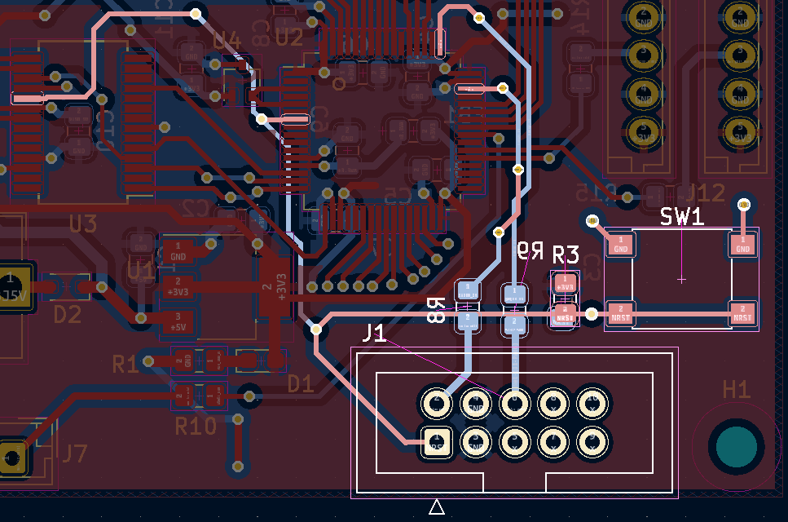
PCB Layout
Programming header And reset switch
Notes:
cameron

Slide 35
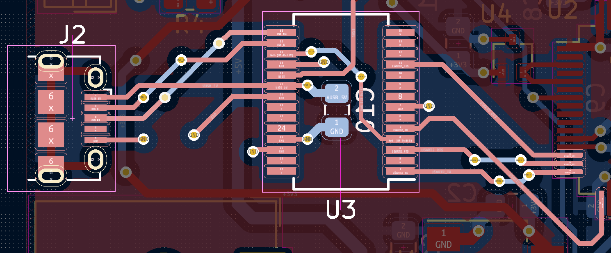
PCB Layout
USB Connector
USB Mini-B Connector through USB<-->UART translator
Notes:
cameron

Slide 36
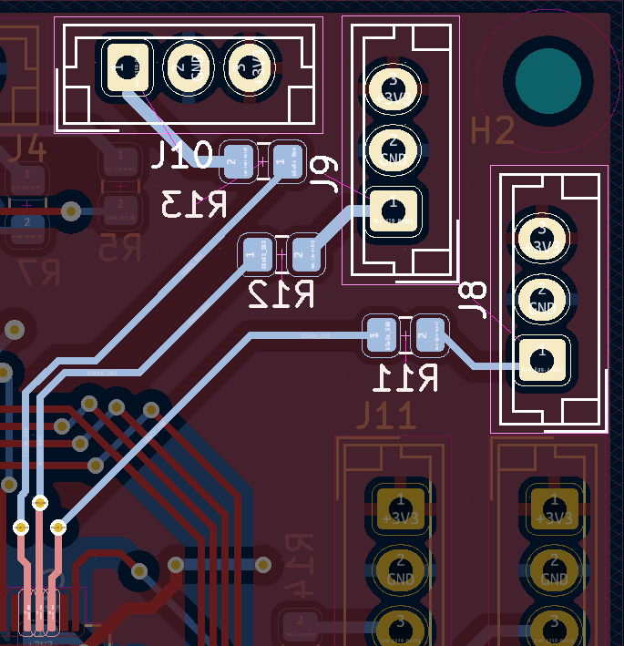
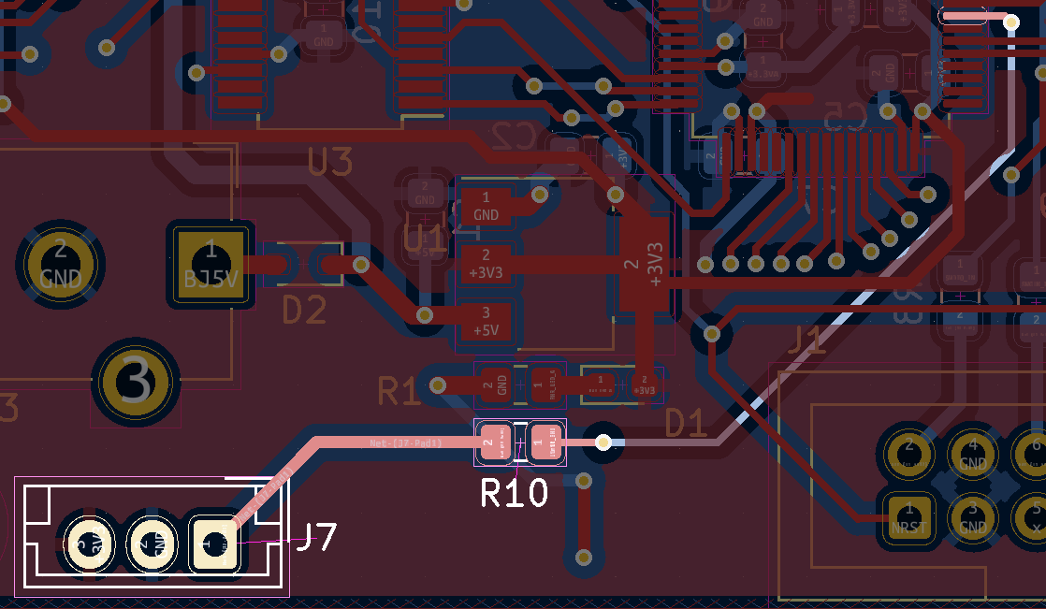
PCB Layout
LIMIT switches
Notes:
cameron

Slide 37
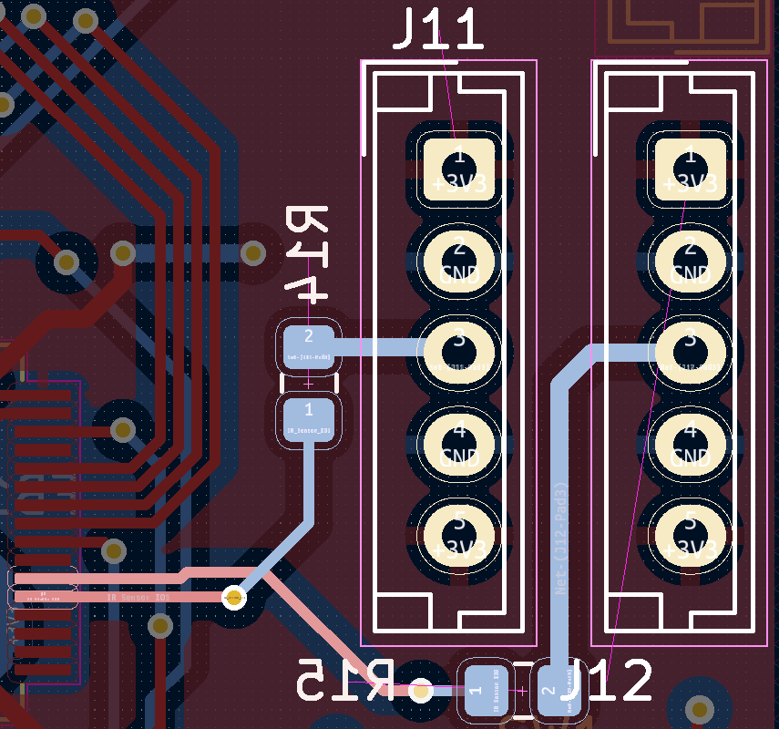
PCB Layout
Break Sensor Signals JOHN
Notes:
cameron

Slide 38
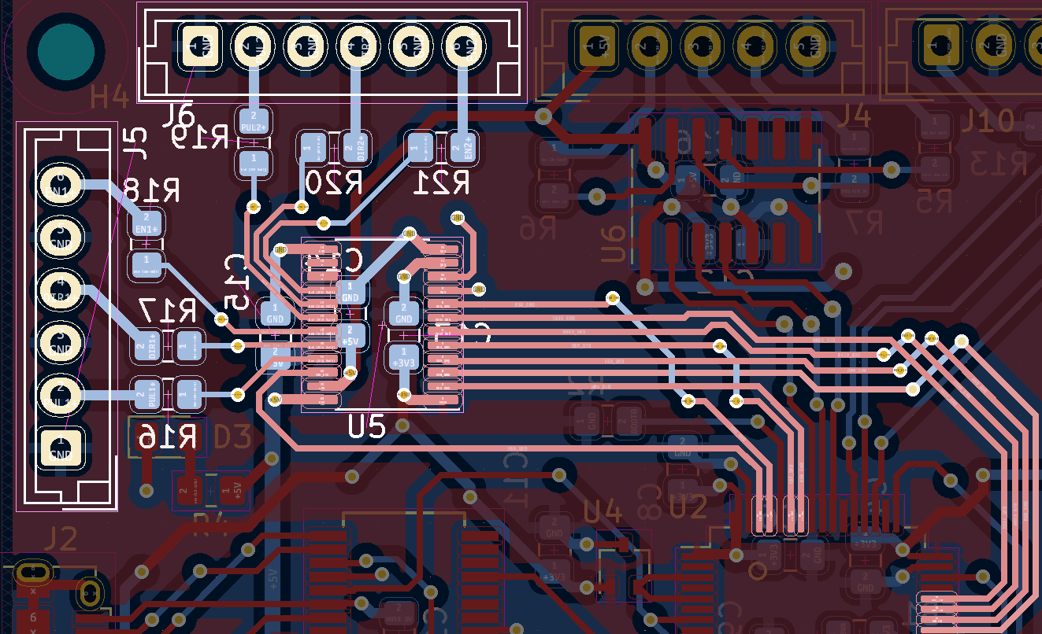
PCB Layout
Motor Control Signals
Notes:
cameron

Slide 39
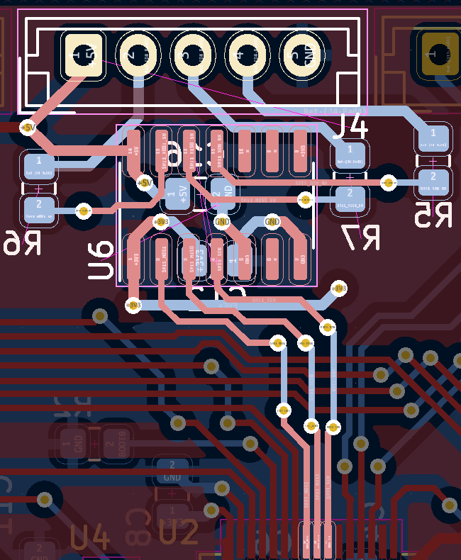
PCB Layout
SPI
Notes:
cameron

Slide 40


PCB Layout
Oscillator and BOOT0
BOOT0
Crystal Oscillator
Notes:
cameron

Slide 41

PCB Layout
SPI overview
Notes:
Include one or more views of your PCB Layout here. If necessary, break up this section into multiple slides detailing various subsystems which are easily viewable (Hint: a zoomed out view of a large electrical schematic in which nothing can be read will not be helpful for the design review). Your layout should be complete, organized, and readable.

Slide 42


Prototyping Progress
Testing and verifying major components
Component
Tested
Working
Notes
Microcontroller
Micro receives data over UART
Camera provides sufficient data to PC
PC identifies projected coordinates of a puck in motion
Micro turns the motors using the motor driver as expected
Micro interfaces with IR sensors to detect goals
Shift registers tested/verified with Arduino
Scoreboard tested and verified with Arduino
LDO has not yet been tested
Camera + PC
Motors
Motor Drivers
IR Sensors
Shift Registers
Scoreboard
LDO
Notes:
Abby
Describe your team’s prototyping progress here. For each of your project’s major components, what has been tested? What is known to work? What still needs to be tested, and what still needs to be proven to work?

Slide 43
Prototyping Progress
Testing and verifying major components
Component
Tested
Working
Notes
Microcontroller
Micro receives data over UART
Camera provides sufficient data to PC
PC identifies projected coordinates of a puck in motion
Micro turns the motors using the motor driver as expected
Micro interfaces with IR sensors to detect goals
Shift registers tested/verified with Arduino
Scoreboard tested and verified with Arduino
LDO has not yet been tested
Camera + PC
Motors
Motor Drivers
IR Sensors
Shift Registers
Scoreboard
LDO
Notes:
Abby
Describe your team’s prototyping progress here. For each of your project’s major components, what has been tested? What is known to work? What still needs to be tested, and what still needs to be proven to work?

Slide 44
Prototyping Progress
Testing and verifying major components
Component
Tested
Working
Notes
Microcontroller
Micro receives data over UART
Camera provides sufficient data to PC
PC identifies projected coordinates of a puck in motion
Micro turns the motors using the motor driver as expected
Micro interfaces with IR sensors to detect goals
Shift registers tested/verified with Arduino
Scoreboard tested and verified with Arduino
LDO has not yet been tested
Camera + PC
Motors
Motor Drivers
IR Sensors
Shift Registers
Scoreboard
LDO
Notes:
Abby
Describe your team’s prototyping progress here. For each of your project’s major components, what has been tested? What is known to work? What still needs to be tested, and what still needs to be proven to work?

Slide 45
Prototyping Progress
Testing and verifying major components
Component
Tested
Working
Notes
Microcontroller
Micro receives data over UART
Camera provides sufficient data to PC
PC identifies projected coordinates of a puck in motion
Micro turns the motors using the motor driver as expected
Micro interfaces with IR sensors to detect goals
Shift registers tested/verified with Arduino
Scoreboard tested and verified with Arduino
LDO has not yet been tested
Camera + PC
Motors
Motor Drivers
IR Sensors
Shift Registers
Scoreboard
LDO
Notes:
Abby
Describe your team’s prototyping progress here. For each of your project’s major components, what has been tested? What is known to work? What still needs to be tested, and what still needs to be proven to work?

Slide 46
Prototyping progress
Fulfilling psdrs
PSDR #1 (Hardware): An ability to use a microcontroller to control the XY directions of a gantry system using PWM and 2 motors.
PSDR #2 (Hardware): An ability to interface with an IC to establish communication and send data between a microcontroller and a PC via UART.
PSDR #3 (Hardware): An ability to interface a seven-segment display scoreboard with shift registers.
PSDR #4 (Hardware): An ability to keep score with a microcontroller by counting the number of times an interrupt is triggered by a puck passing through an infrared laser beam.
PSDR #5 (Software): An ability to estimate the position and trajectory of a puck in motion using computer vision.
Notes:
abby

Slide 47


Prototyping Progress
Mechanical prototyping
Goals modified to support smooth image processing
Motor mounts 3D printed to fit into the side of the table
Side rails recently arrived, prototyping in progress
Notes:
Abby
Describe your team’s prototyping progress here. For each of your project’s major components, what has been tested? What is known to work? What still needs to be tested, and what still needs to be proven to work?

Slide 48

Mechanical prototyping
Gantry System
Notes:
cameron

Slide 49

Software Development Status
PC Components
Notes:
joey

Slide 50

Software Development Status
Microcontroller components
Notes:
joey

Slide 51

Software Development Status
Puck tracking on Pre-recorded video
Notes:
joey

Slide 52

Software Development Status
Puck tracking on Live video
Notes:
joey

Slide 53

Project Timeline
Gantt Chart
Notes:
joey

Slide 54
3D Printing
Questions?

